Slide 1
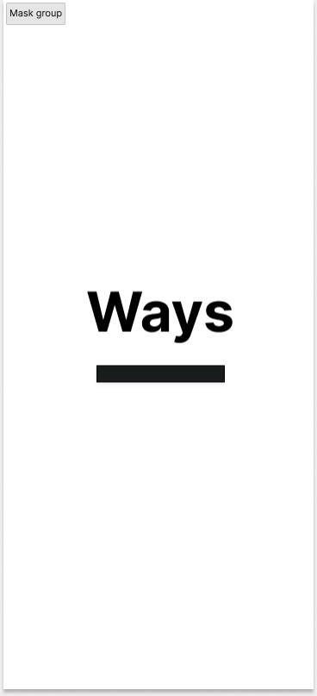
UI DESIGN OF WAYS
RIDE SAFE WITH WAYS

Slide 2

Delay Page Apart from making the app more attractive, the importance of this page is to make our user remember our app in order to promote it to their friends and families. This will make a free source of advertisement because it have been proven that a recommendation from a friends or family members have more values.

Slide 3
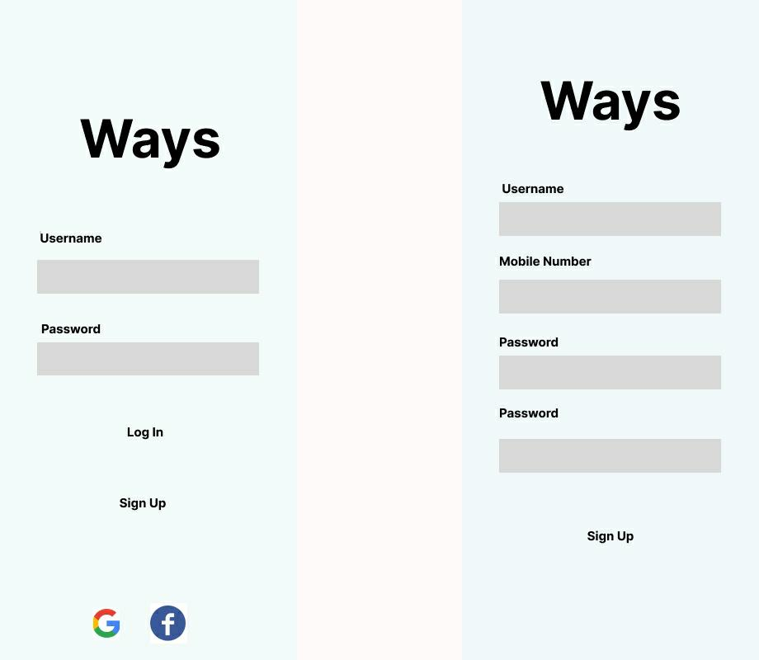
Login & Registration
→ When the app is lunch on a device for the first time, the sign-in page is loaded which requires the user to input his log-in details and have the possibility to log-in with google or facebook accounts.
→ In case the User is new, he can click the sign-up button and fill in the information needed.

Slide 4
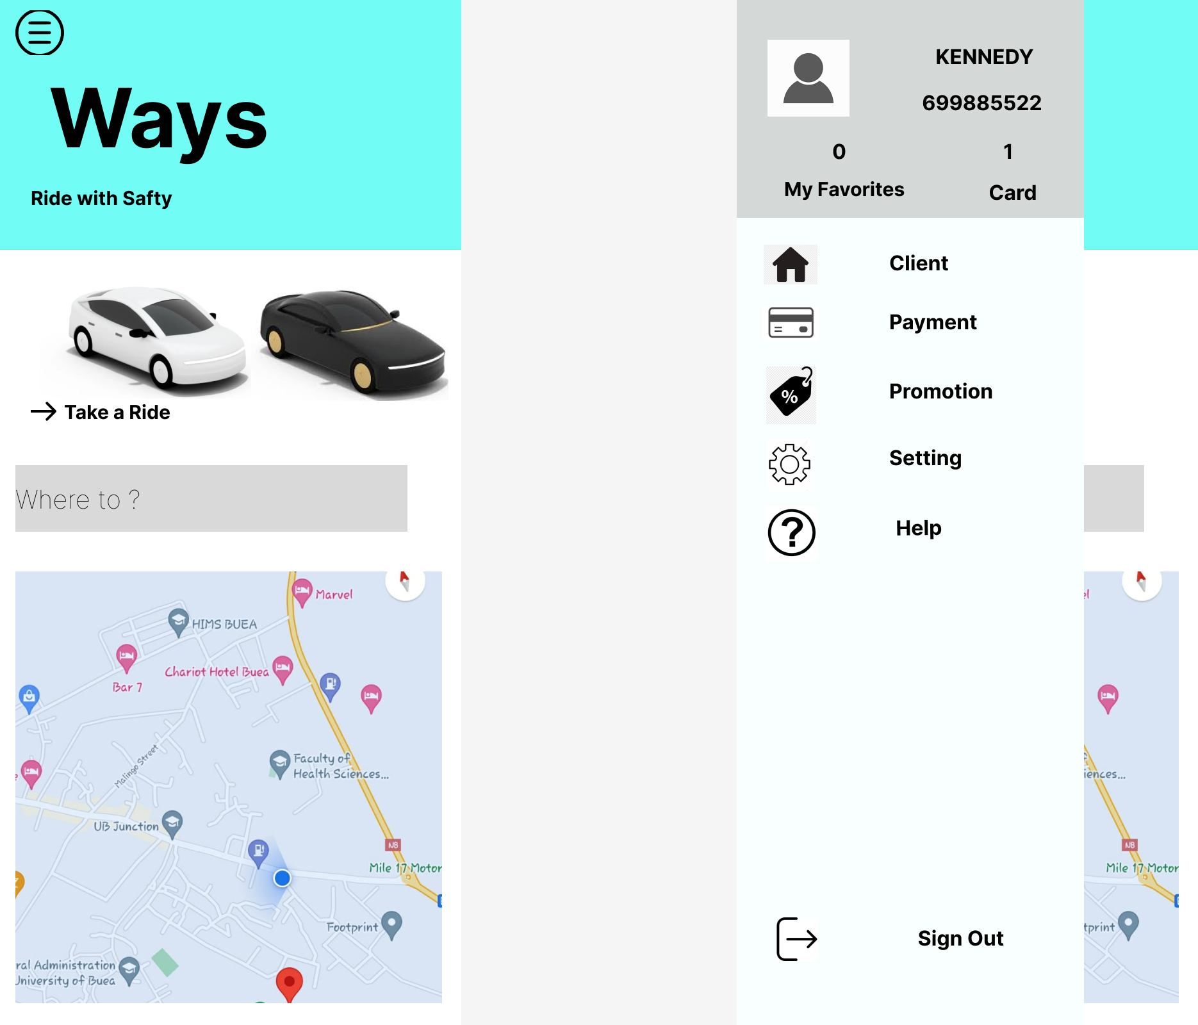
Dashboard The Dashboard of our app is going to contain the current location of the user and he/she can view his position on the map. → On the right top corner of our app is a menu button which help our user to navigate easily around the app.

Slide 5
Booking a Ride
→ When a User want to take a ride, he/she is directed to this page where he can input his location.
→ When a location is entered, the user is redirected to another page where he can view the path to his destination. Then the user have to make choice on the type of car depending on his wealth.
→ After the choice is made, must confirm the ride by paying for his ride. Then a notification is sent to the driver.

Slide 6
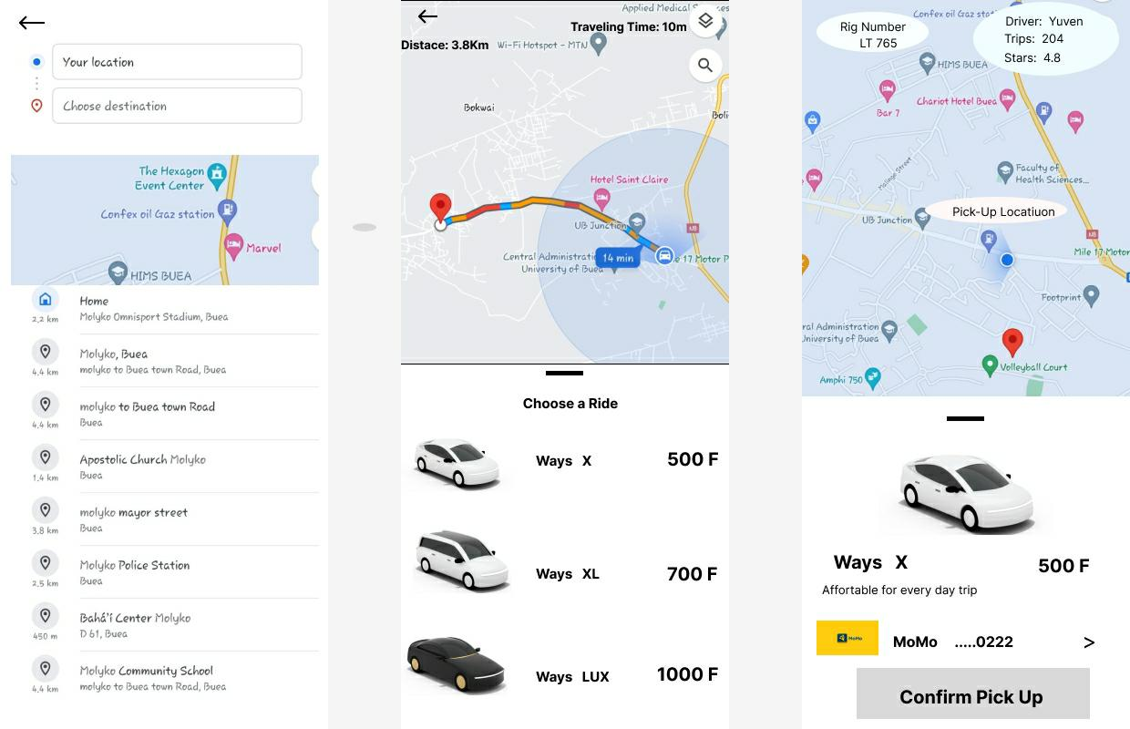

Slide 7
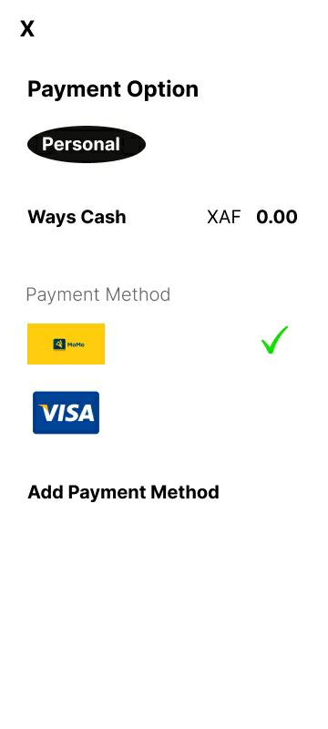
Payment Option → This page contain the financial status of the user where he can view his account balance. He also have the possibility to add new payments account (momo and bank card).

Slide 8


